Slide 1


TCS3254
PROGRAMMING FOR
MOBILE DEVICES
TCS3254
PROGRAMMING FOR
MOBILE DEVICES
WEB AND MOBILE
DEVELOPMENT
Mobile application DEVELOPMENT PROCESS
Building Layout using Widgets
Application Environment and Framework
1
1

Slide 2
INTRODUCTION
The process of mobile app development is a structured journey that transforms an idea into a fully functional application.
It involves multiple phases, each critical to ensuring a successful product that meets user expectations and business goals.
From initial planning and concept validation to UI/UX design, development, testing, and deployment, every step plays a key role in shaping the final app.

Slide 3
Mobile Application Development Process
An effective app development process flow spans over the following common phases:
  Strategy
  Analysis and Planning
  UI / UX Design
  App Development
  Testing
  Deployment & Support

Slide 4
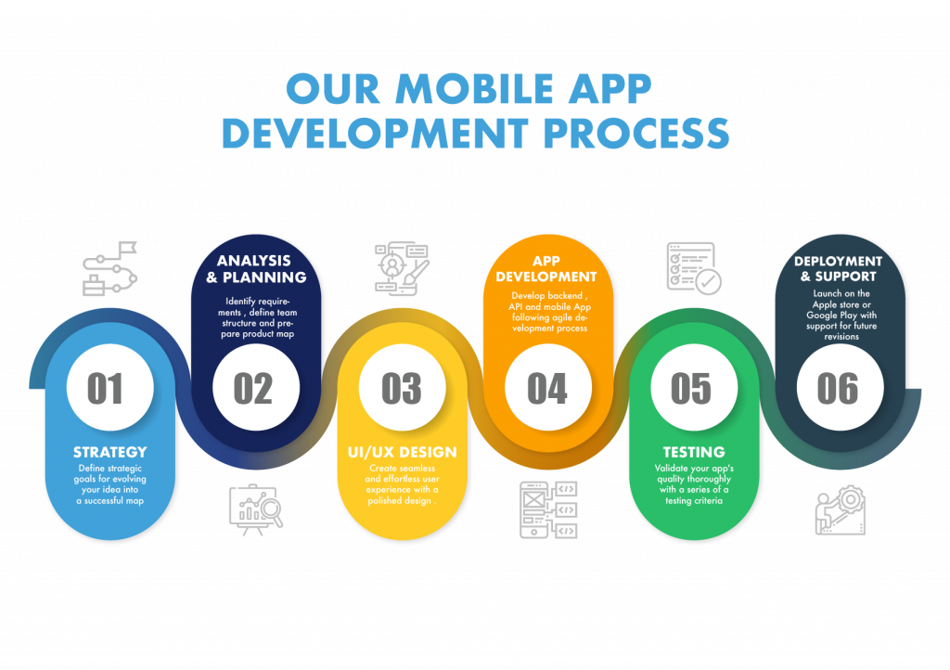
MOBILE APPLICATION DEVELOPMENT PROCESS

Slide 5
1. Strategy
The first phase of the mobile app development process is defining the strategy for evolving idea into a successful app.
In this phase, you will:
  Identify the app users
  Research the competition
  Establish the app’s goals and objectives
  Select a mobile platform for your app

Slide 6
2. Analysis and Planning
Analysis and planning begin with defining use cases and capturing detailed functional requirements.
This includes prioritizing the mobile app requirements and grouping them into delivery milestones. Also includes:
  identifying the skills needed for the development
  identifying the name of the app - names are like domain names and must be unique.

Slide 7
3. UI / UX Design
The purpose of an app’s design is to deliver seamless and effortless user experiences with a polished look.
The success of a mobile app is determined based on how well users are adopting and benefiting from all its features.
The goal for mobile app is creating excellent user experiences (e.g., interactive, user-friendly, and intuitive user experiences to keep the user's engagement).

Slide 8
3. UI / UX Design
To design a mobile or web apps, it requires lot of imagination, conceptualization, and creativity to put together with technology.
There are lots of iteration processes required to make an application functionally accurate and visually appealing.

Slide 9
3. UI / UX Design
  The methods and deliverables are:
  Information Architecture & Workflows
  The first step of the app design process is to determine the workflows – (how) data will display to the users, the data it will collect, user interactions with the finished product, and the user journeys within the app.
  Workflow diagrams – help identify every possible interaction a user has with the app and the app’s navigation structure.

Slide 10
3. UI / UX Design
  Wireframes
  Mobile app designers often start app design with sketches on paper. Wireframes are the digital form of sketches.
  Wireframes are conceptual layouts, also referred to as low-fidelity mockups to give visual structure of the app’s functional requirements.

Slide 11
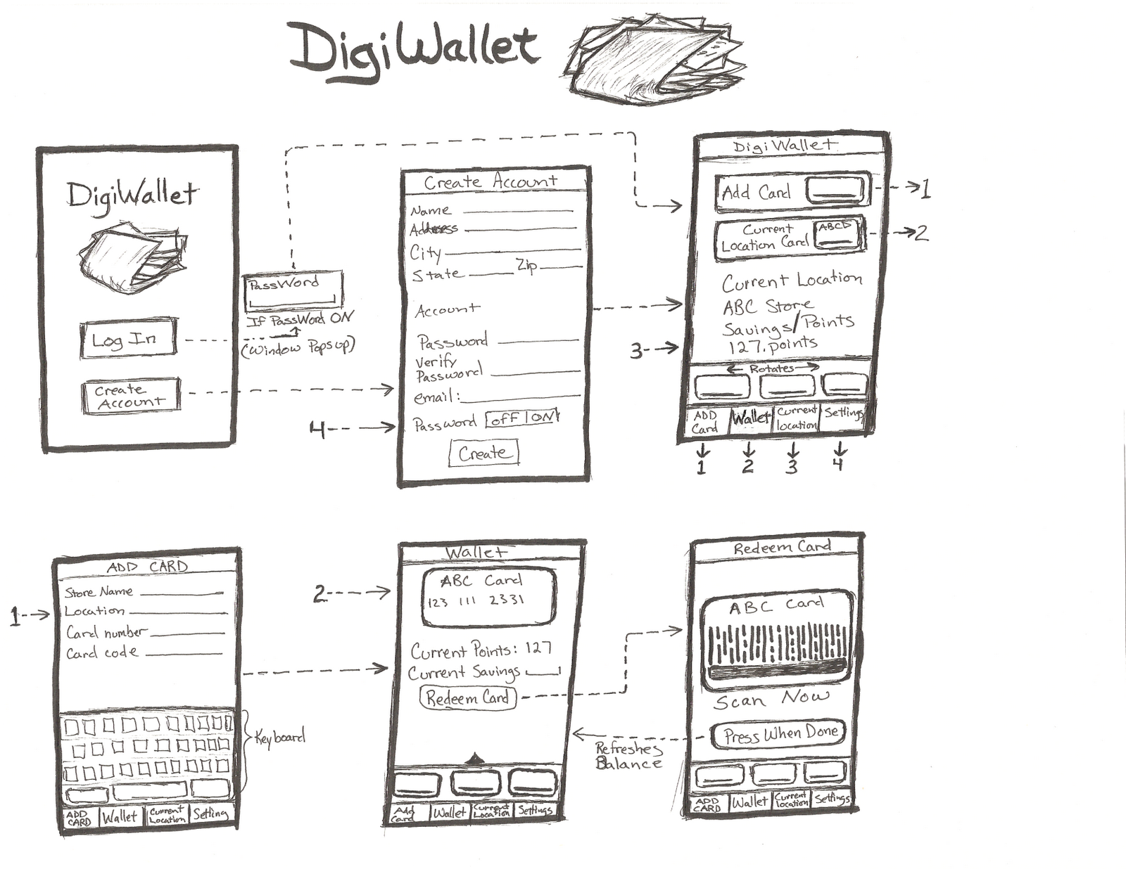
3. UI / UX Design

Slide 12
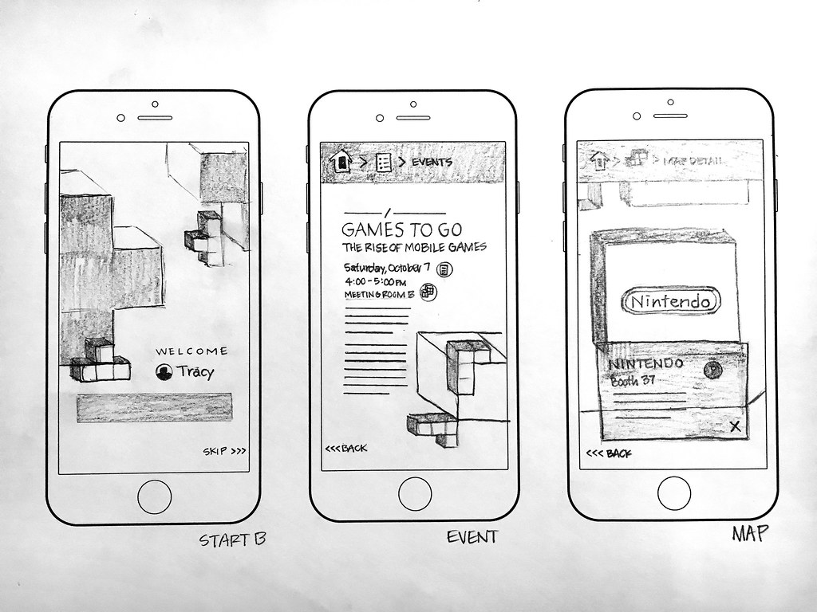
3. UI / UX Design

Slide 13
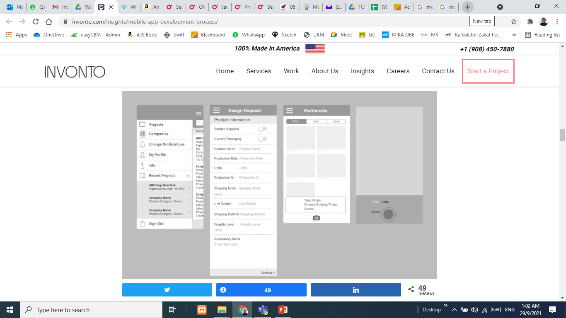
3. UI / UX Design
Creating wireframes is a quick and cost-effective approach for designing app layouts and iterating through them in the design review process.

Slide 14
3. UI / UX Design
Style Guide - living documents where an app’s design standards from the company’s branding rules down to the navigation icons that contribute to an app’s design strategy.
Style guides include:
  What font family will the app’s text use?
  What will the color scheme be?
  How will the company brand be reflected in the app design?

Slide 15
3. UI / UX Design
Establishing a style guide early on as part of the mobile app development process expand the productivity of the mobile apps.
By having these guidelines early on, the team can maintain consistency across the app, reduce time spent on design and development decisions, and streamline collaboration, leading to faster and more productive app creation.

Slide 16
3. UI / UX Design
Also need to consider app design guidelines for Android (Material Design Guidelines) and iOS apps (Human Interface Guidelines).
These guidelines outline best practices for creating apps that provide a consistent, user-friendly experience across devices.
They cover aspects like navigation patterns, visual design, user interaction, and accessibility.

Slide 17
3. UI / UX Design
Mockups
  Mockups, or high-fidelity designs, are the final renderings of your app’s visual design.
  Mockups are produced by applying the style guide to the app wireframes.
  As the app’s design begins to finalize, expect further modifications to its information architecture, workflow, and aesthetics.

Slide 18
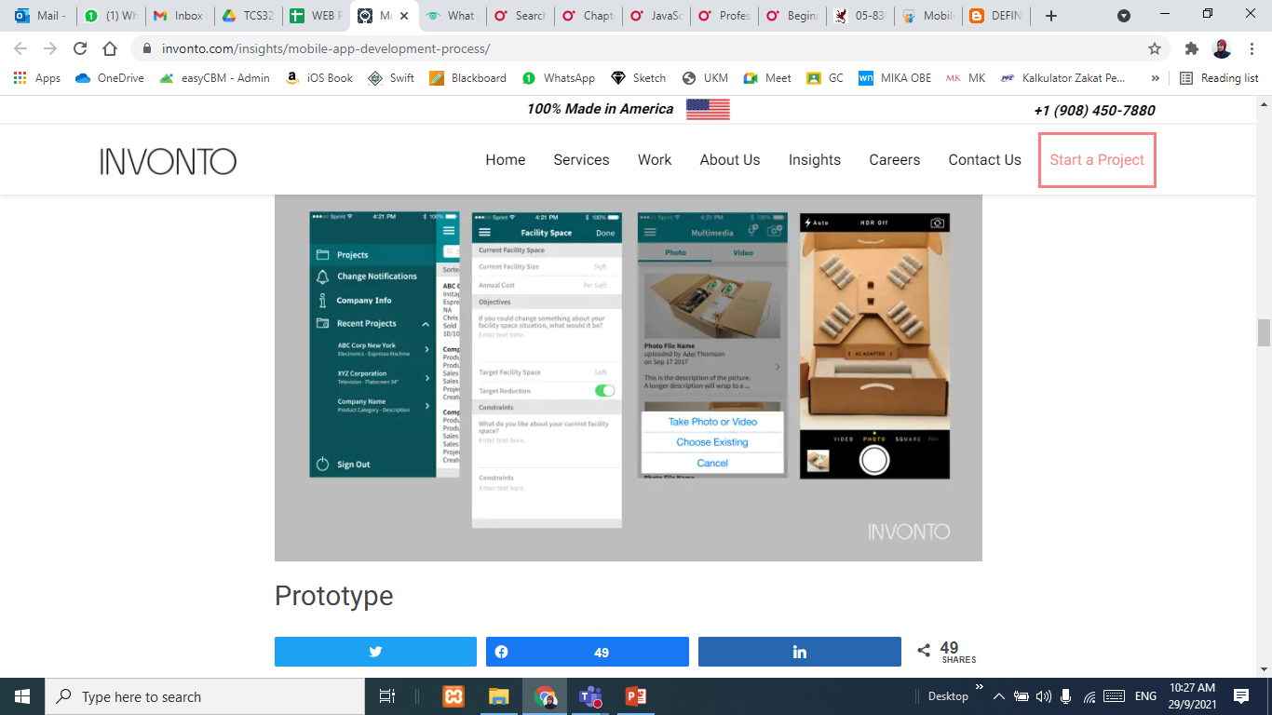
3. UI / UX Design

Slide 19
3. UI / UX Design
Prototype
  Prototypes are highly useful for simulating the user experience and the app’s workflows expected from the completed product.
  The prototypes help identify modifications to the app’s proposed functionality. Some companies prefer even doing prototypes at a wire-framing stage, particularly when an app’s functional requirements are not well thought out.

Slide 20
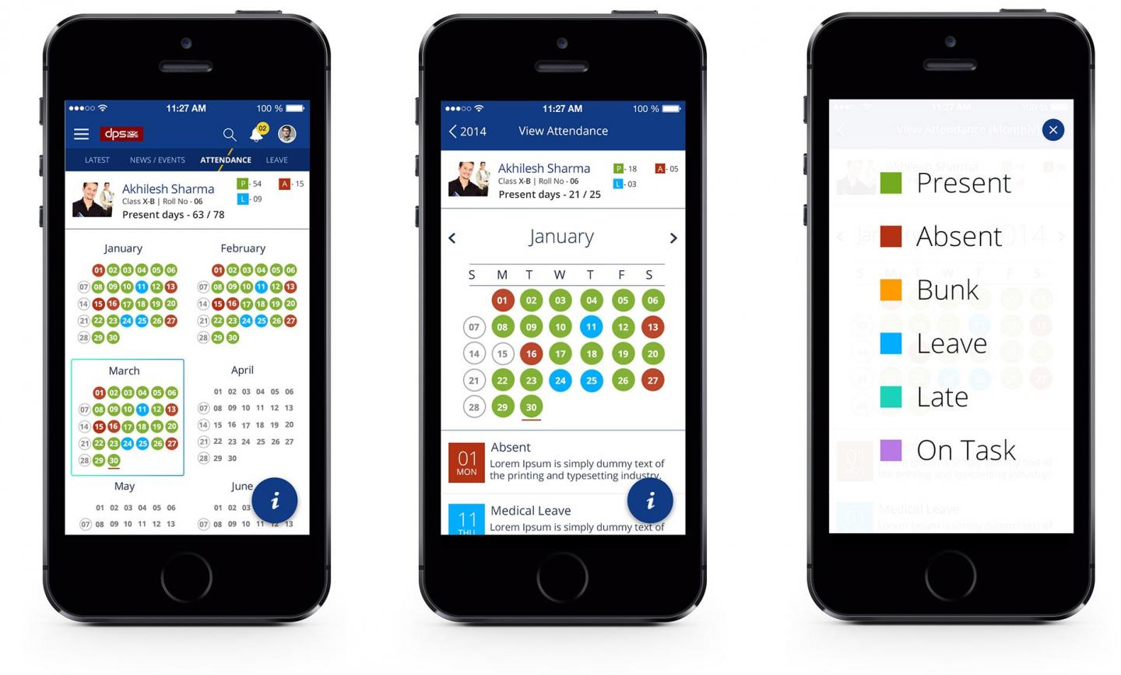
3. UI / UX Design

Slide 21
4. App Development
A typical mobile app project is made up of three integral parts:
  back-end/server technology - technology stack that is best suited for the apps (i.e. database and server-side objects, programming languages, & framework)
  API(s) - method of communication between the app and a back-end server/database
  front-end - the native mobile app an end-user will use

Slide 22
5. Testing
Performing quality assurance (QA) testing during the mobile app development process makes applications stable, usable, and secure.
To ensure comprehensive QA testing of the app, first need to prepare test cases that address all aspects of app testing.
Similar on how use cases drive the process of mobile app development, test cases drive mobile app testing.

Slide 23
5. Testing
The app should undergo the following testing methods:
  User experience testing
  Functional testing
  Performance testing
  Security testing
  Device & Platform testing

Slide 24
5. Testing
User Experience Testing
Objective: to ensure that the final implementation matches the user experience created by the app design team.
It is important the app employs consistent fonts, style treatments, color scheme, padding between data, icon design, and navigation, and matches the original design guidelines!

Slide 25
5. Testing
Functional Testing
The functionality of the app should be tested by as many users to cover as many potential testing conditions.
Objective: to ensure that users can use the app’s features and functionality without any issues.
The testing is further into system testing (as a whole), and unit testing (individual functions).

Slide 26
5. Testing
Performance Testing
Quantitative criteria to use for measuring the performance such as:
  How well the app responding to the user requests?
  How fast are the app’s screens loading?
  Is the app draining the phone battery or causing memory leaks?
  Does the app leverage network bandwidth efficiently?
  Is the size of the app bigger than what it should be?
  How the app handle the when usage spikes.

Slide 27
5. Testing
Security Testing
Security is of utmost concern for enterprise mobile apps. Any potential vulnerability can lead to a hack.
Many companies hire outside agencies to perform thorough security testing on their app.
QA & development teams can take a few simple measures to make the app secured e.g., data entry forms should be tested to ensure there is no data leakage.
Notes:
Example:
If the app requires users to log in, these log in sessions should be tracked on the device and the backend. User sessions should be terminated by the system when a user has remained idle for an extended time.

Slide 28
5. Testing
Device and Platform Testing
Mobile operating systems are updated every few months. Also, the devices come in different sizes and shapes.
Thus, the app must be tested on multiple mobile devices or device simulators to ensure smooth working of the app for all users.

Slide 29
5. Testing
The complexity of mobile app testing on all mobile devices, ongoing support costs, and headaches of mobile device management are primary reasons why companies tend to build their enterprise mobile apps for a single mobile platform.
Testing is imperative to an app’s future success.
Having a comprehensive mobile testing strategy is a must for delivering a quality mobile app.
Notes:
Most companies tend to develop their enterprise mobile app first with Apple’s iOS mobile platform; only where needed they build an app for the Android platform.
During the testing phase, there are many ways for distributing the app development builds to the testers.
The most common approach with iOS apps is using the Testflight and for Android apps via email or Over The Air (OTA) installs.

Slide 30
6. Deployment & Support
Releasing a native mobile app requires submitting the app to Apple App Store and Google Play Store.
For that, a developer account with Apple App Store and Google Play Store is required.
The iOS apps need to go through a review process which may take from a few days to several weeks depending on the quality of the app & guidelines.
Notes:
Example:
If the app requires users to log in, then you will need to provide Apple with a test user account as part of the release process.

Slide 31
6. Deployment & Support
For Android apps, there isn’t any review process - the app will become available within a few hours of submission.
After the app is become available, monitor its usage through mobile analytics platforms and track Key Performance Indicators (KPIs) for measuring the app’s success.
Also need to frequently check for crash reports, or other user reported issues.

Slide 32
6. Deployment & Support
For support, let users to provide feedback and suggestions on app to keeping users engaged.
Unlike web apps where patch releases can be available to app users instantly, mobile app updates will have to go through the same submission and review process as the initial submission.
The native mobile apps must continually stay on top of technology advancements and routinely update the app for new mobile devices and OS platforms.

Slide 33
SUMMARY
The mobile app development process is a structured approach that transforms an idea into a functional and user-friendly application.
A well-defined process helps minimize risks, improve app quality, enhance user experience, and increase market success.
Additionally, it streamlines team collaboration by ensuring all team members—designers, developers, and testers—are aligned and working towards a common goal, improving efficiency and communication.

